Slide 1

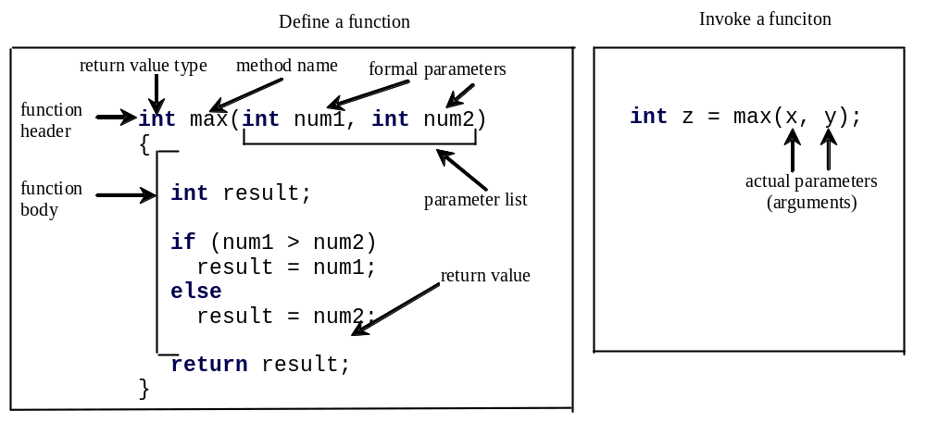
Introducing Functions
A function is a collection of statements that are grouped together to perform an operation. For example, when you call the pow(a,b), the system actually executes several statements in order to return the result.
Notes:
Function is a basic type of module.
A function to find which of two integers is bigger.
The definition of function means implementing an operation or a sequence of operations using some statements. The invoke of function means using the function.
Formal parameters are defined in the function header. Actual parameters are defined in the calling function.

Slide 2
Introducing Functions, cont.
A function declaration consists of a function header and a function body.
The function header specifies the return value type, function name, and parameters of the function.
The function body contains a collection of statements that define what the function does.

Slide 3
Introducing Functions, cont.
The variables defined in the function header are known as formal parameters.
When a function is invoked, you pass a value to the parameter. This value is referred to as actual parameter or argument.

Slide 4
Introducing Functions, cont.
A Function may return a value. The returnValueType is the data type of the value the function returns. If the function does not return a value, the returnValueType is the keyword void.

Slide 5
Calling Functions
Listing 5.1 Testing the max Function
This program demonstrates calling a Function max to return the largest of the int values
TestMax

Slide 6
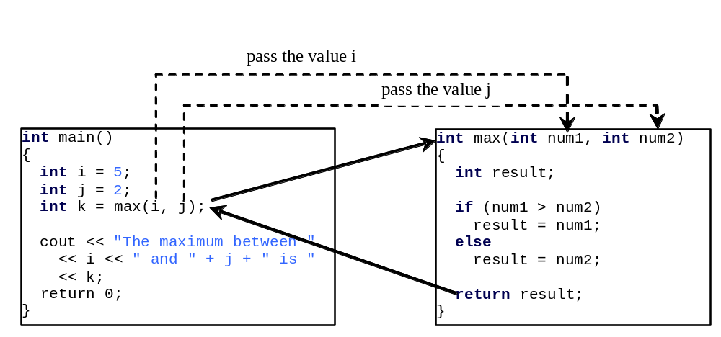
Calling Functions, cont.
animation
When a program calls a function, program control is transferred to the called function. A called function returns control to the caller when its return statement is executed or when its function ending closing brace is reached.
Notes:
When the max function is invoked, the flow of control transfers to the max function. Once the max function is finished, it returns the control back to the caller.

Slide 7
Trace Function Invocation
animation
i is now 5

Slide 8
Trace Function Invocation
animation
j is now 2

Slide 9
Trace Function Invocation
animation
invoke max(i, j)

Slide 10
Trace Function Invocation
animation
invoke max(i, j)
Pass the value of i to num1
Pass the value of j to num2

Slide 11
Trace Function Invocation
animation
declare variable result

Slide 12
Trace Function Invocation
animation
(num1 > num2) is true since num1 is 5 and num2 is 2

Slide 13
Trace Function Invocation
animation
result is now 5

Slide 14
Trace Function Invocation
animation
return result, which is 5

Slide 15
Trace Function Invocation
animation
return max(i, j) and assign the return value to k

Slide 16
Trace Function Invocation
animation
Execute the print statement

Slide 17
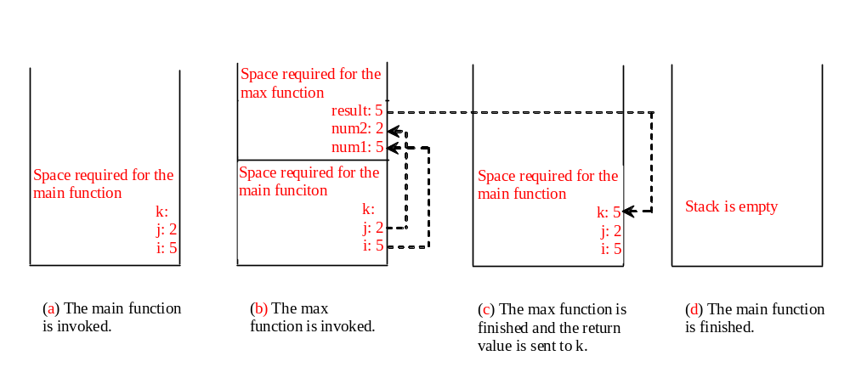
Call Stacks
Each time a function is invoked, the system stores its arguments and variables in an area of memory, known as a stack, which stores elements in last-in-first-out fashion. When a function calls another function, the caller’s stack space is kept intact and new space is created to handle the new function call. When a function finishes its work and returns to its caller, its associated space is released.
Notes:
Main memory can be divided four areas, stack, data, instruction and extra.

Slide 18
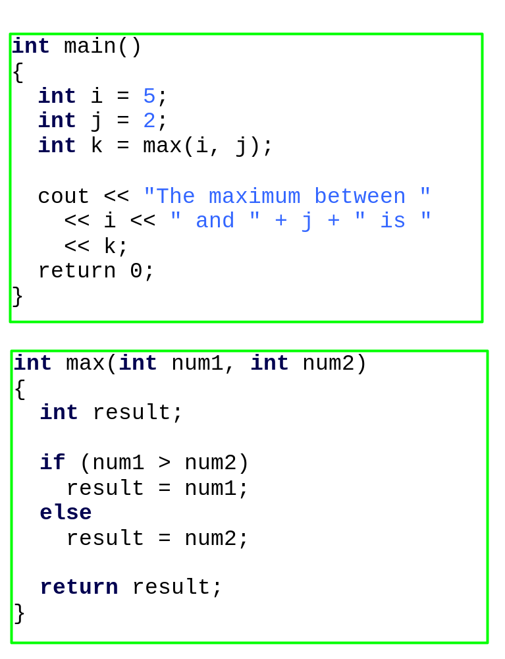

Trace Call Stack
animation
i is declared and initialized

Slide 19
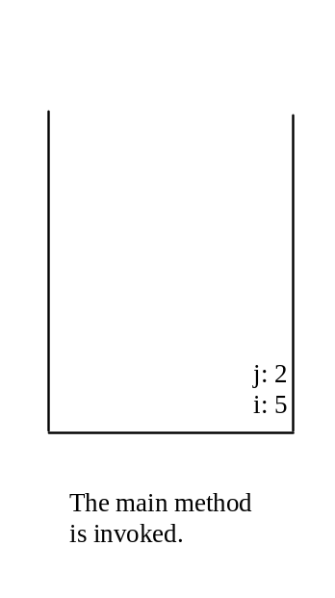
Trace Call Stack
animation
j is declared and initialized

Slide 20
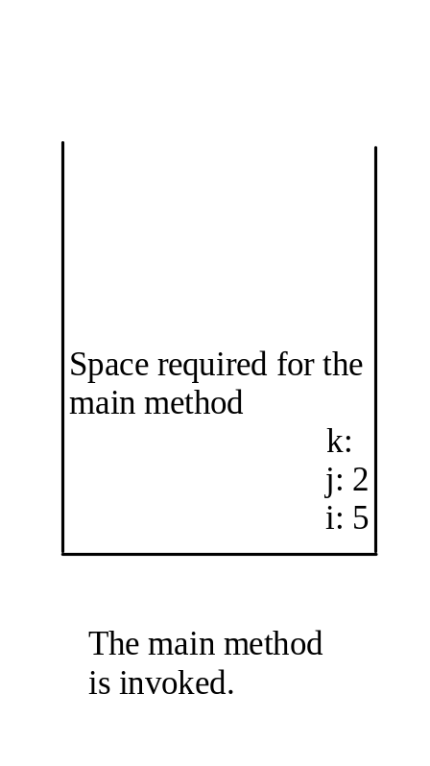
Trace Call Stack
animation
Declare k

Slide 21
Trace Call Stack
animation
Invoke max(i, j)

Slide 22

Trace Call Stack
animation
pass the values of i and j to num1 and num2

Slide 23
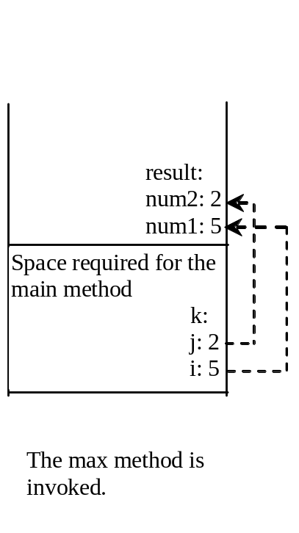
Trace Call Stack
animation
(num1 > num2) is true

Slide 24
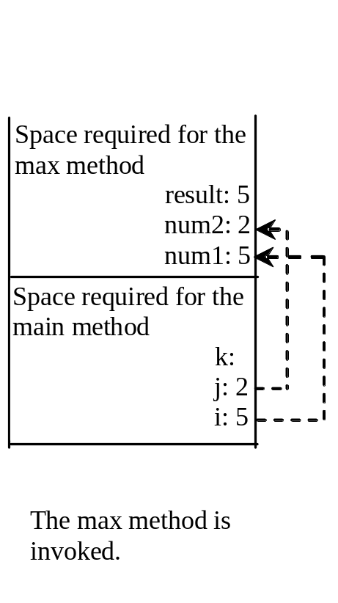
Trace Call Stack
animation
Assign num1 to result

Slide 25

Trace Call Stack
animation
Return result and assign it to k

Slide 26
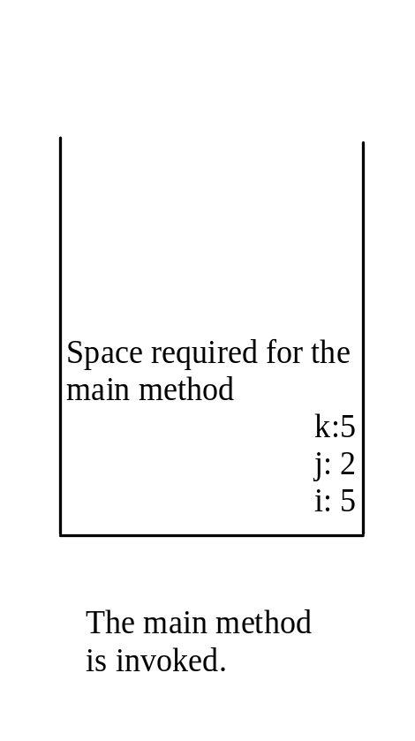
Trace Call Stack
animation
Execute print statement

Slide 27
void Functions
The preceding section gives an example of a nonvoid function. This section shows how to declare and invoke a void function. Listing 5.2 gives a program that declares a function named printGrade and invokes it to print the grade for a given score.
TestVoidFunction

Slide 28
Pass Parameters by Values
When you invoke a function with a parameter, the value of the argument is passed to the parameter. This is referred to as pass-by-value. If the argument is a variable rather than a literal value, the value of the variable is passed to the parameter. The variable is not affected, regardless of the changes made to the parameter inside the function. We will examine an interesting scenario in the following example, in which the parameters are changed in the function but the arguments are not affected.
TestPassByValue

Slide 29
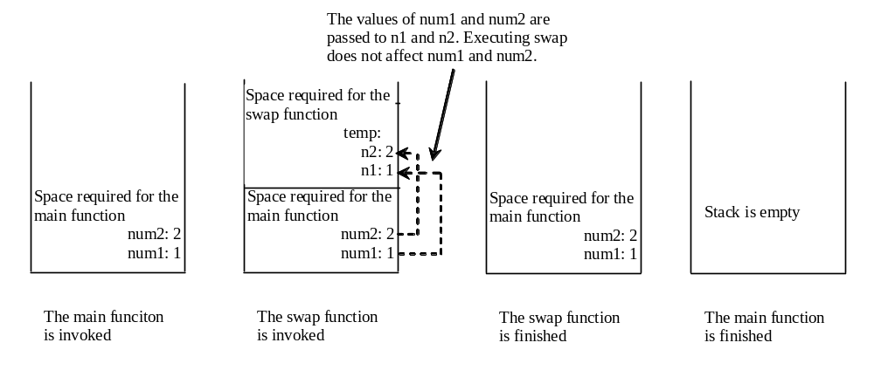
Pass Parameters by Values, cont.

